Slide 1
Welcome to TEAMS 3.2
An Introduction
Carrie Tupa
Texas Workforce Commission
December 6, 2017
Notes:
Hello, this is Carrie Tupa with the Texas Workforce Commission. I want to welcome you to the first training webinar for TEAMS version 3.2.

Slide 2
Welcome
This is the biggest overhaul to the TEAMS system we’ve completed since the transition to TWC
DON’T PANIC
Notes:
This release is by far the biggest overhaul to the TEAMS system that has been completed since the initial transition of the system to the Texas workforce Commission.
You will hear me say several times throughout this webinar to NOT panic, and that’s very important.

Slide 3

Really. Don’t Panic.
Notes:
Again, really, don’t panic. A lot of what you will see is brand new, but the way we’ve designed certain things is very intentional – basically, we’ve built ON to the existing system in a way that allows you to still continue business as usual. I cannot stress enough that while a lot of what you see is brand new, there should be NO hindrances to your usual processes – just enhancements to the amount and type of information you are able to track.

Slide 4
Multi-phased Roll-Out
Pre-recorded Webinars
Interactive Training
Virtual real-time training
Notes:
I want to start by explaining our roll-out process for this system enhancement. You are participating in this first phase of the roll out which is the pre-recorded webinar. There are 2 pre-recorded webinars that will be available this week. We’ve broken down this information into smaller, more digestible chunks.
In this initial webinar, you will see a high level overview of changes. We will then move into more details in the coming webinar to enhance your understanding.
We will have an interactive training available hopefully next week that will walk you through changes on a slower basis and clarify key fundamentals to assist you in understanding.
Finally, we will be hosting a virtual training series beginning the week of December 18. This series will be offered 1-2 times a week, and will be open to a small enough group of individuals that we can have considered time for questions.
You will find that as we roll these changes out, we will expect that you have participated in these events as they are a way for us to most quickly and efficiently reach large numbers of users.

Slide 5
What’s in the Release
Tracking of MSG’s allowable under WIOA, including:
  Educational Functioning Level Gain Type A – Achievement on a Pre/Post Test (in any domain)
  Educational Functioning Level Gain Type B – Transition to Postsecondary Education after Exit
  High School Equivalency Achievement
  Skills Progression (for IET Participants)
Tracking of Credentials Earned
Tracking of Post-Exit Enrollment in Postsecondary Education
Improvements to the Training Screen, including
  Enhanced Filtering for programs on the ETP
Bug Fixes Including:
  Training hours being calculated in elapsed hours between tests
Notes:
So lets start by talking about what’s in this release:.
This release includes the ability to track all measurable skill gains –MSG’s – allowable under WIOA, including:
Educational Functioning Level Gain Type A – Achievement on a Pre/Post Test (in any domain)
Educational Functioning Level Gain Type B – Transition to Postsecondary Education after Exit
High School Equivalency Achievement
Skills Progression (for IET Participants)
Tracking of Credentials Earned
Tracking of Post-Exit Enrollment in Postsecondary Education
Improvements to the Training Screen, including
Enhanced Filtering for programs on the ETP
Bug Fixes Including:
Training hours being calculated in elapsed hours between tests

Slide 6
Part 1: What’s the same
Notes:
So I want to do things a little backwards here and start by talking about what’s the same with this release. I’m doing this to ensure that there is no halt in your work as I know this time of year is a busy one for progress testing and entering data.

Slide 7
What’s the Same in 3.2
Tracking assessments (pre/post tests) hasn’t changed
  Outcomes have a different name
  Outcomes are tracked on all domains
Tracking training hasn’t changed, it’s just more user friendly
Everything else is the same
Notes:
So, I will start by sharing that the tracking of assessments (pre/post tests) hasn’t changed. We did this on purpose to alleviate issues with transitioning from one process to another in tracking information. So, for tracking of MSG type 1a) achievement on a pre/post test, you will still enter assessments as you always have.
You will notice, as we will show later, that pre/post test achievements have changed slightly in that the name of the screen where you view these outcomes has changed, and gains are now calculated on all domains, something I know everyone is very excited about.
Additionally, the tracking of training services hasn’t changed. However, there are changes that make the tracking of programs that are a part of the Eligible training provider system easier.
Everything else is the same – and when I say that, I mean that, functionally, the system is still the same, and the ability to track participants, classes, staff, and contact hours hasn’t changed in any way that will prevent you from using the system.

Slide 8
Part 2: So What’s Different Then?
Notes:
So, let’s talk about what’s different.

Slide 9
Changes to Adding Training Services in 3.2
A more user-friendly approach for programs on the ETP list
Notes:
Let’s start by looking at changes that have been made to the training services screen which make it easier to track programs on the eligible training provider list.

Slide 10
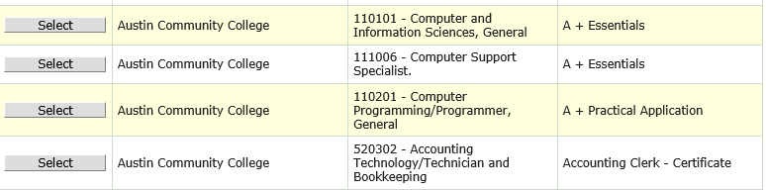
For Providers on the ETP List
You now have the option to “select” the eligible training provider
Programs on the ETP list are tied to a specific occupation, so you will essentially select a program and occupation at the same time
Notes:
As a reminder, when selecting a program from the eligible training provider system, you should ensure that you are working with an actual program –not just a provider – in the system. While most community colleges are on the eligible training provider list, not all of their program offerings are. The changes to the training screen ensure that, when you are selecting a program from the ETP list, you are truly selecting that program, not just the entity that offers the program.

Slide 11
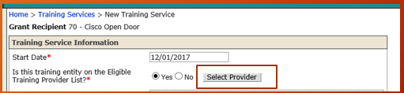
Step 1: “Select Provider”
Notes:
To select a provider from the ETP list, you will now see the option to “select provider” when you select “yes”, that the program is on the ETP list.

Slide 12
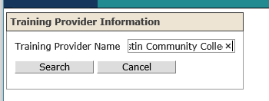
Step 2: Search for your Provider Name
Notes:
Once you have selected “yes”, you will search for your provider. You can enter all or part of the provider name. As with most searches, we recommend using enough characters to find the record you are looking for, but not too many so as to accidentally omit results based on spelling.

Slide 13
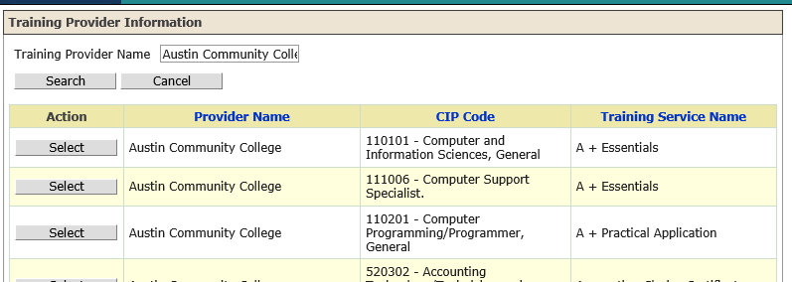
Step 3: Select the “Provider Name”
You’ll select the provider, picking the one associated with the CIP for which you are providing
Hint – you can “sort” by CIP by clicking the “CIP Code” Header for easy finding!
Notes:
After searching, you see the results of your provider. Each provider entry is associated with the actual ETP program, so, for instance, if you entered Austin Community College, you’d see all of their offerings and would need to select the correct one based on the CIP code.
You can sort by CIP code by simply clicking on the CIP code column header. This will allow you to more easily find the program you’re looking for.

Slide 14
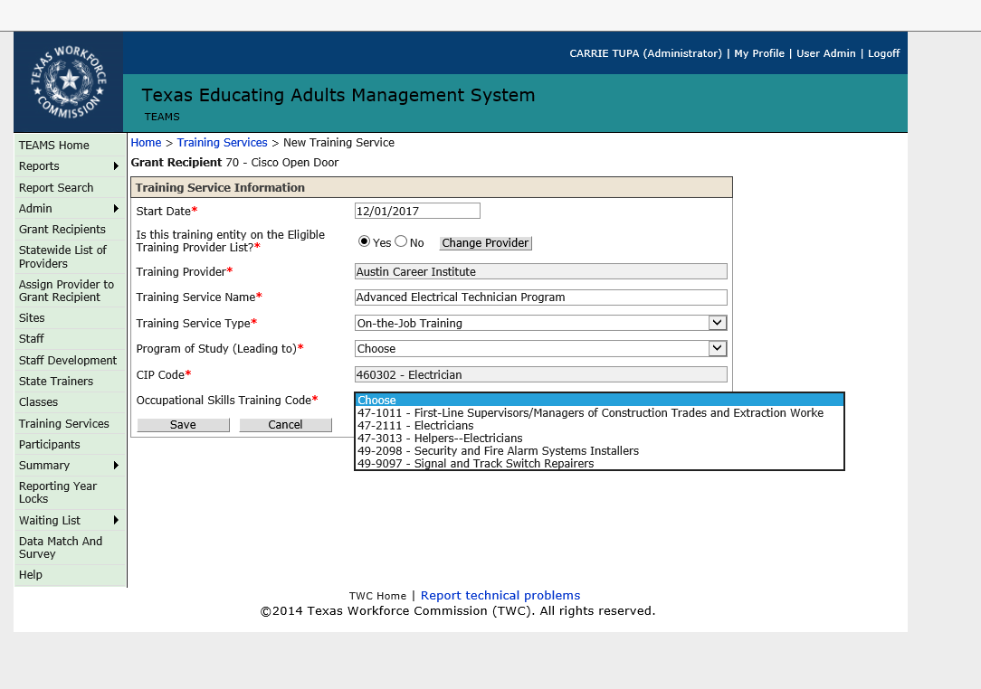
Step 4: Information Available for the ETP Populates
Most programs on the ETP have a training service type, and possibly a program of study tied to them
  If the program you select doesn’t have this information in the database, you’ll need to select the correct option
The occupational skills training code options only provide options associated with that program and CIP in the ETPS
Notes:
Once you’ve selected the program, you’ll notice that certain fields will now autopopulate based on information stored in the ETP database. If certain information is missing, you’ll need to select the correct option.
Occupational skills training codes will also automatically filter based on the associated codes for a particular ETP program, so you’ll have fewer options to sort through when selecting the appropriate program.

Slide 15
New Section: Educational Outcomes
Notes:
Now I want to move to the biggest change –t he educational outcomes screen. This is a participant screen, meaning each participant – much like they have an assessments screen (sometimes called a “tab” as well) – has one.

Slide 16
Educational Outcomes Screen
The new Educational Outcomes screen captures, for each participant:
  Measurable Skill Gains
  Credentials and Certifications
  Post-Exit Educational Enrollment
Notes:
The educational outcomes screen, captures for each participant, information associated with their measurable skill gains, credentials/certificates, and educational enrollment.
I want to start by defining what each of these things are, then talk about why they are on this page, and how they work together.

Slide 17
Measurable Skill Gains Allowable Under Title II
1) Educational Functional Level Gain
  1a) Achievement on a Pre/Post-Test
  1b) Enrollment in Post-secondary Education
2) Achievement of Diploma/Equivalent
5) Skills Progression (includes):
  Successful passing of an exam that is required for a particular occupation; or
  Achievement of progress in attaining technical or occupational skills as evidenced by as evidenced by Trade-related Benchmarks, such as knowledge-based exams
Notes:
So, let’s start with measurable skill gains.
I’m going to say this a few times –this is NOT a policy webinar, and if you are not familiar with the policy behind these things, you will want to start by learning that. I will reference our policy materials on this topic in a bit.
But, just as a refresher, the measurable skill gains for MSG’s allowable under WIOA are –
Educational Functional Level Gain
1a) Achievement on a Pre/Post-Test
1b) Enrollment in Post-secondary Education
2) Achievement of Diploma/Equivalent
5) Skills Progression (includes):
Successful passing of an exam that is required for a particular occupation; or
Achievement of progress in attaining technical or occupational skills as evidenced by as evidenced by Trade-related Benchmarks, such as knowledge-based exams

Slide 18
Credentials (a summary)
Credentials under WIOA include:
  Secondary (as in a High School Equivalency)
  Postsecondary (as in certificate or a degree)
Credential types include:
  High School Equivalency
  AA/AS Degree
  BA/BS Degree
  Occupational Licensure
  Occupational Certificate
  Occupational Certification
Notes:
Credential allowable under WIOA include secondary and postsecondary credentials.
These include High School Equivalency
AA/AS Degree
BA/BS Degree
Occupational Licensure
Occupational Certificate
Occupational Certification

Slide 19
Remember! HSE as a Credential and MSG
HSE as Credential
HSE as MSG
Individuals who:
Denominator:
  Lack HSE/Diploma
  Are considered in a program at the secondary education level (more on this later)
  Spanish or English
  Exit
Numerator:
  HSE earned during participation within one year of exit
  Are enrolled in postsecondary ed or training within one year after exit
  OR
  Are employed within one year after exit
  Within the program year
  Spanish or English
  Matched to TEA matches or potential matches
  High school equivalencies earned outside of Texas can be manually entered
Notes:
This is a good time to remind you that high school equivalency counts as both a credential and a measurable skill gain under WIOA, depending on the circumstances under which it’s received and when the participant exits.
The HSE as a credential includes Individuals who:
Denominator:
Lack HSE/Diploma
Are considered in a program at the secondary education level (more on this later)
Spanish or English
Exit
Numerator:
HSE earned during participation within one year of exit
Are enrolled in postsecondary ed or training within one year after exit
OR
Are employed within one year after exit
The HSE as a measurable skill gain must:
Within the program year
Spanish or English
Matched to TEA matches or potential matches
High school equivalencies earned outside of Texas can be manually entered

Slide 20
Educational Enrollment – A Summary
We must capture educational enrollment for the purposes of:
  Determining if a credential “counts”
  Determining if an MSG (Type 1b – Enrollment in postsecondary education) has been achieved
Notes:
And finally, a summary of educational enrollments. It’s important to stress here that when we talk about educational enrollments, we are talking about post-exit educational enrollment – so this is tracking what happens after a student has exited. This information is collected for the purposes of:
Determining if a credential “counts”
Determining if an MSG (Type 1b – Enrollment in postsecondary education) has been achieved

Slide 21
A refresher on the policy
(we won’t cover that here)
Visit:
http://www-tcall.tamu.edu/twcael/AELMaterials.html
for a summary of Accountability under WIOA
Notes:
For a refresher on the policy, I invite you to review our materials from the summer institute. These materials can be found and the website listed here.

Slide 22
Additional Policy Guidance In the Works
An AEL letter we anticipate coming out very soon will include:
  What “counts” for what
  What documentation is required to keep on file
  Who is in the credential denominator
Notes:
Please also keep in mind that an AEL letter outlining details of this policy will be issued in the coming weeks.
This letter will clarify what counts for which measure, what documentation you need to keep on file for certain measures, and which participants are included in the credential denominator.

Slide 23
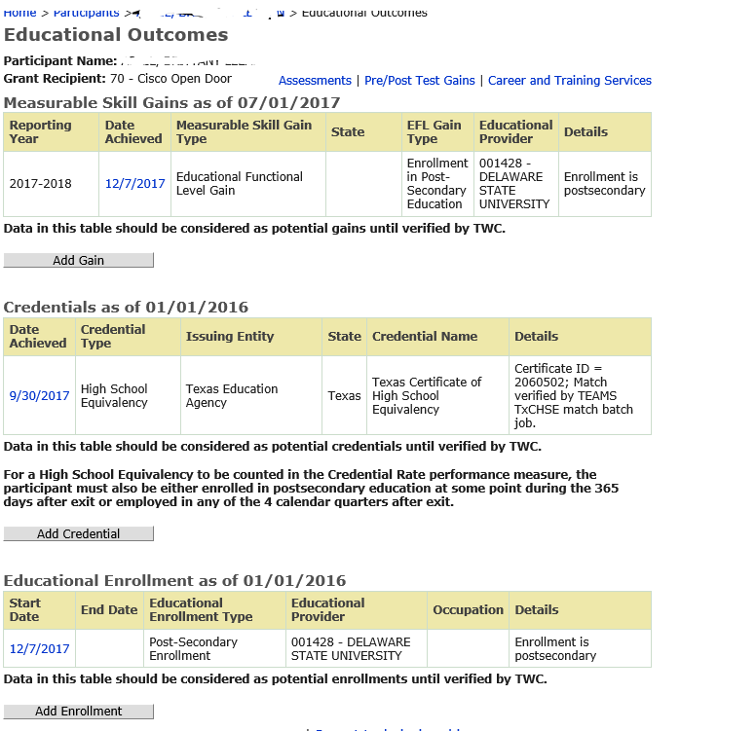
What Does it Look Like
Notes:
So now on to what this new screen looks like.

Slide 24

Remember…Don’t Panic!!
Notes:
Again, remember, don’t panic.

Slide 25
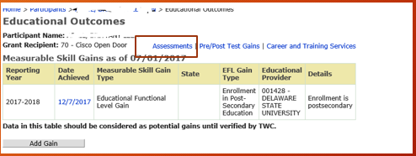
What You “Know” Is Still the Same (Assessments)
Assessment still get tracked on the “assessments” screen
Notes:
As I shared in the beginning of the webinar, there are piece of this that are still the same.
Assessments still get entered in the same way on the assessments screen.

Slide 26
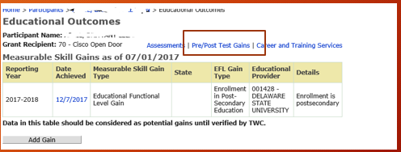
What You “Know” Is Still the Same (EFL Gains)
What used to be called “outcomes” is now “Pre/Post Test Gains”
  All your historical pre/post test gains will still live here
  All your current EFL Type 1a, “achievement on a pre/post test” will still live here
Notes:
And what used to be called “outcomes” is now called “pre/post test gains”. All of your historical pre/post test gains will still live here and
All your current EFL Type 1a, “achievement on a pre/post test” will still live here

Slide 27

But wait, there’s more…
The Pre/Post Test Gains now calculates gains in any domain, as allowable under WIOA
Notes:
However, there’s one key change – gains are no counted for each domain as is allowable under WIOA. So, a gain is simply a gain, no matter what domain the gain has taken place in.

Slide 28
Now the New Stuff
Notes:
So now let’s move to the new stuff

Slide 29
But First…
This is the first of a two-part pre-recorded webinar series
More training opportunities are coming, as outlined in the beginning of the webinar
Notes:
First, I want to stress that this is the first of a two-part pre-recorded webinar series
As shared in the beginning of the webinar, more training opportunities are coming. This first webinar is simply a high-level overview of these changes.

Slide 30
Adding Measurable Skill Gains
An Introduction
Notes:
So let’s start with the new measurable skill gains.

Slide 31
Where/How Do I Add New MSG’s?
MSG Type | How it’s Added | Where you will see it | What you need to know
1a) Educational Functioning Level Gain: Achievement on a Pre-Post Test | Add an assessment as you always have | Assessment Screen Pre/Post Test Gain Screen (as applicable) Educational Outcomes Screen | You will see gains for all domains. If a gain is made in multiple domains, multiple records will show on the Educational Outcomes Screen
1b) Enrollment in Post-secondary Education | Add a new record to the MSG table OR Add a new record to the Educational Enrollment table (it will show on both) | MSG table and the Educational Enrollment Table on Educational Outcomes Screen | TEAMS does not calculate exit yet. This gain requires an exit, so you will see a caveat that the gain may not count
Notes:
I’ve provided here a summary table of how various MSG’s are added and where you will see them. As shared earlier in this webinar, we haven’t changed the process for adding assessments in an effort to phase in these changes and not change business as usual.
As you can see from this first row, for MSG type
1a) Educational Functioning Level Gain: Achievement on a Pre-Post Test
Add an assessment as you always have
Assessment Screen
Pre/Post Test Gain Screen (as applicable)
Educational Outcomes Screen
You will see gains for all domains. If a gain is made in multiple domains, multiple records will show on the Educational Outcomes Screen
1b) Enrollment in Post-secondary Education
Add a new record to the MSG table OR
Add a new record to the Educational Enrollment table (it will show on both)
MSG table and the Educational Enrollment Table on Educational Outcomes Screen
TEAMS does not calculate exit yet. This gain requires an exit, so you will see a caveat that the gain may not count

Slide 32
Where/How Do I Add New MSG’s? (cont’d)
MSG Type | How it’s Added | Where you will see it | What you need to know
2) Achievement of Diploma/ Equivalency – IN STATE | Added through HSE match process | MSG table and Credentials table on Educational Outcomes Screen | TEAMS does not include employment yet, or credential denominator information. This gain requires employment or enrollment in postsecondary and being in the denominator to count as a credential so you will see a caveat that the gain may not count
2) Achievement of Diploma/ Equivalency – OUT OF STATE | Add record to the MSG table OR Add a record to the credential table | MSG table and Credentials table on Educational Outcomes Screen | TEAMS does not include employment yet, or credential denominator information. This gain requires employment or enrollment in postsecondary and being in the denominator to count as a credential so you will see a caveat that the gain may not count
Notes:
2) Achievement of Diploma/ Equivalency – IN STATE
Added through HSE match process
MSG table and Credentials table on Educational Outcomes Screen
TEAMS does not include employment yet, or credential denominator information. This gain requires employment or enrollment in postsecondary and being in the denominator to count as a credential so you will see a caveat that the gain may not count
2) Achievement of Diploma/ Equivalency – OUT OF STATE
Add record to the MSG table OR
Add a record to the credential table
MSG table and Credentials table on Educational Outcomes Screen
TEAMS does not include employment yet, or credential denominator information. This gain requires employment or enrollment in postsecondary and being in the denominator to count as a credential so you will see a caveat that the gain may not count

Slide 33
Where/How Do I Add New MSG’s? (cont’d) 2
MSG Type | How it’s Added | Where you will see it | What you need to know
5) Skills Progression (includes): Successful passing of an exam that is required for a particular occupation; OR Achievement of progress in attaining technical or occupational skills as evidenced by as evidenced by Trade-related Benchmarks, such as knowledge-based exams | Add record to the MSG table | MSG table on the Educational Outcomes screen | This type of MSG is only allowable to individuals in an IET, but is not yet tied to the training component, so you will see a caveat that it may not count.
Notes:
5) Skills Progression (includes):
Successful passing of an exam that is required for a particular occupation; OR
Achievement of progress in attaining technical or occupational skills as evidenced by as evidenced by Trade-related Benchmarks, such as knowledge-based exams
Add record to the MSG table
MSG table on the Educational Outcomes screen
This type of MSG is only allowable to individuals in an IET, but is not yet tied to the training component, so you will see a caveat that it may not count.

Slide 34
Adding New Records
The Basics
Notes:
So what exactly is meant by adding a new record. Adding new records is a process to manually add records for certain types of MSG’s, credentials, and post-exit educational enrollment.

Slide 35
New Records
The process for adding new records is fairly similar for MSG’s, Credentials and Educational Enrollment
  Remember, certain MSG’s, Credentials and Educational Enrollments are added through other means (data match, assessment screen); see the table on slides 31-33 for a refresher.
Not all fields are relevant for all record types. If you see something grayed out or auto-populated, it’s supposed to do that!
Notes:
The process for adding new records is fairly similar for MSG’s, Credentials and Educational Enrollment
Remember, certain MSG’s, Credentials and Educational Enrollments are added through other means (data match, assessment screen); see the table on slides 31-33 for a refresher.
Not all fields are relevant for all record types. If you see something grayed out or auto-populated, it’s supposed to do that!

Slide 36
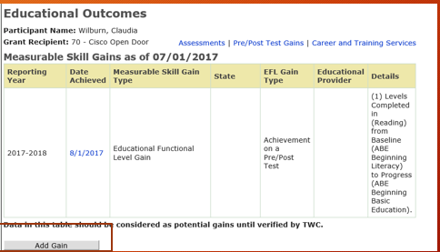
Example: Adding a Type 5 MSG
Notes:
So let’s look at an example of adding a type 5 MSG for this participant. First, I want to show you that this participant has already earned an EFL gain, achievement on a pre-post test. The details are automatically added in the details column. You could also go to the Pre/Post test gains to see the details of the gains on this participant.
But now, we’re going to assume that this participant is in an IET, so we can capture a Type 5 MSG.
So I’m going to click on “add gain”.
This add button is the same for adding all types of new records.

Slide 37
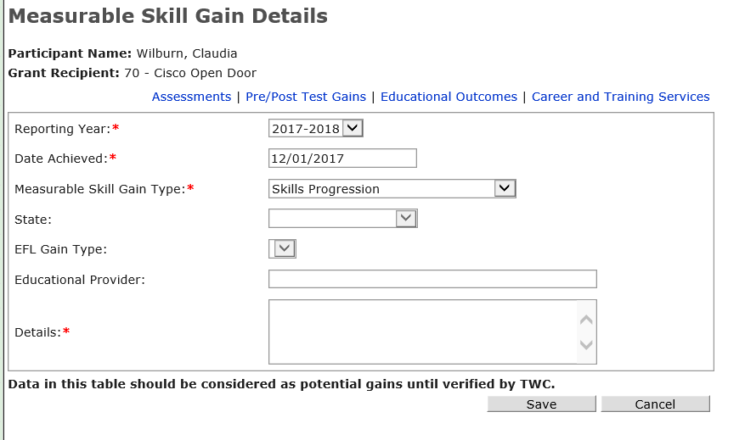
Adding a Type 5 MSG (cont’d)
Only certain types will appear in this dropdown (Type 1a) Pre/Post Test Gain and Type 2) HSE – In State are added through other processes)
Notes:
As shared earlier, Only certain types of MSG’s can be added through this “add record” process, and so that is all that will appear in this dropdown- (Type 1a) Pre/Post Test Gain and Type 2) HSE – In State are added through other processes)

Slide 38
Adding a Type 5 MSG (cont’d) 2
If a field is grayed out or can’t be selected, it means it’s not relevant for this particular type of gain
Notes:
Again, if a field is grayed out or can’t be selected, it means it’s not relevant for this particular type of gain. So, in this record, State is not relevant – we will go into more depth on which fields are required for which gains in the second webinar.

Slide 39
Adding a Type 5 MSG (cont’d) 3
For records that require an educational provider, you will notice that, as you begin to type, the field auto-populates from the national database of FICE codes for purposes of data consistency
Notes:
For records that require an educational provider (for example, post-exit enrollment into postsecondary education), you will notice that as you begin to type, this field auto-populates from the database of FICE codes. We’ve built in this functionality wherever a database of data exists to ensure consistency of data entry and to build more comprehensive reporting functionality.

Slide 40
Adding a Type 5 MSG (cont’d) 4
Providers should have a consistent process for how they record details related to a new record.
We recommend including the type of documentation on file for the participant.
Notes:
And finally, for all records you’ll see a required details column
I want to stress here that Providers should have a consistent process for how they record details related to a new record.
We recommend including the type of documentation on file for the participant.

Slide 41
Important Notes
Adding certain types of records is a whole new world for AEL.
  If it seems “too good to be true” – IT IS. Remember, documentation, documentation, documentation.
All participants still need a baseline assessment for eligibility purposes.
Notes:
Some important notes –
The ability to add certain types of records (for example, certificates and postsecondary credentials) is a whole new world for AEL.
If it seems “too good to be true” – IT IS. Remember, documentation, documentation, documentation. You will be reminded constantly as you add records that there is an expectation that you keep documentation on file verifying outcomes. Again, allowable documentation types will be covered in the AEL letter. While we hope to build in functionality into the system in the future that allows you to actually upload documentation, we’re not there yet with this release.
And remember, while you now have multiple options to show gains – and other outcomes – for participants - All participants still need a baseline assessment for eligibility purposes

Slide 42
Up next…
Detailed explanation of adding records for:
  MSG’s
  Credentials
  Educational Enrollment
Interactive training PowerPoint
Virtual training opportunities
Notes:
And that’s IT for this webinar. Please stay tuned for the next webinar in this series, to be released on Friday, December 8. This webinar will cover more explicit detail on adding records.
Additionally, please stay tuned for details on more training opportunities for the new TEAMS system.

Slide 43
Thank you!
Notes:
Thank you so much and have a great day!

